Slide 1
H1-B Project
Nupur ChauhaN
Batch Code : S180017
Student id: S170020100444

Slide 2

What is Big Data ?
'Big Data' is a term used to describe collection of data that is huge in size and yet growing exponentially with time.
Big data is a term that describes the large volume of data – both structured and unstructured – that inundates a business on a day-to-day basis.
When we combine big data with high-powered analytics, we can accomplish business-related tasks such as:
Determining root causes of failures, issues and defects in near-real time.
Generating coupons at the point of sale based on the customer’s buying habits.
Recalculating entire risk portfolios in minutes.
Detecting fraudulent behavior before it affects your organization.

Slide 3



Examples of Big Data
The New York Stock Exchange everyday generates about 1 terabyte of trade data
Single Jet engine can generate 10+terabytes of data in 30 minutes of a flight time. With many thousand flights per day, generation of data reaches up to many Petabytes.
Statistic shows that 500+terabytes of new data gets ingested into the databases of social media site Facebook, every day. This data is mainly generated in terms of photo and video uploads, message exchanges, putting comments etc

Slide 4
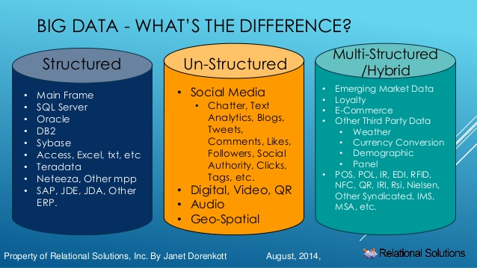
Categories of Big Data
Any data that can be stored, retrieved, and processed in the form of definite format is called structured data
Any data with unacquainted form or structure is classified as unstructured data.
Semi structured data is the data which has not been organized into a unique repository such as a database, however, in spite of that has associated information, such as metadata that makes it more responsible for processing than unstructured data

Slide 5
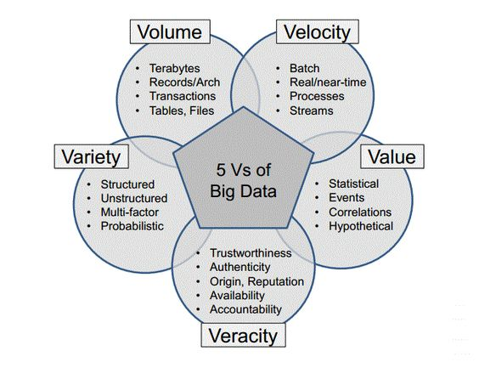
Characteristics of Big Data

Slide 6
Importance of Big Data
Understand the market conditions: Analyzing big data helps understanding current market conditions. For example; by analyzing customers’ purchasing behaviors, a business can find out the products that are sold the most and produce its future products according to this trend. As a result, it can get ahead of its competitors.
Understand customers better: A business can understand its customers better with the help of big data analysis. It can predict what its customers want in advance and provide them a better service in addition to better products. Also, businesses can minimize customer complaints easily using big data tools, since these tools can automatically detect negative comments on social media. As a result, you can act promptly.
Control your online reputation: Big data tools can do sentiment analysis. Therefore, you can get more feedback about who is saying what about your company. If you want to monitor and improve the online presence of your business, then, big data tools are a must-have for you.
Cost Savings: Implementing big data tools may be expensive at the beginning but it will eventually save you a lot of money. Big data tools reduce the burden of IT staff, since they are real time systems. Therefore, you can use these resources somewhere else. Also, storing large amounts of data is much easier using big data technologies but more importantly, the data you store will be accurate because big data tools has greatly reduced the risk of inaccurate data.

Slide 7

Apache Hadoop
Apache Hadoop is an open source software platform for distributed storage and distributed processing of very large data sets on computer clusters built from commodity hardware.
Hadoop services provide for data storage, data processing, data access, data governance, security, and operations.
According to its co-founders, Doug Cutting and Mike Cafarella, the genesis of Hadoop was the "Google File System" paper that was published in October 2003.
Doug Cutting, who was working at Yahoo! at the time, named it after his son's toy elephant.
The core of Apache Hadoop consists of a storage part, known as Hadoop Distributed File System (HDFS), and a processing part which is a MapReduce programming model.

Slide 8
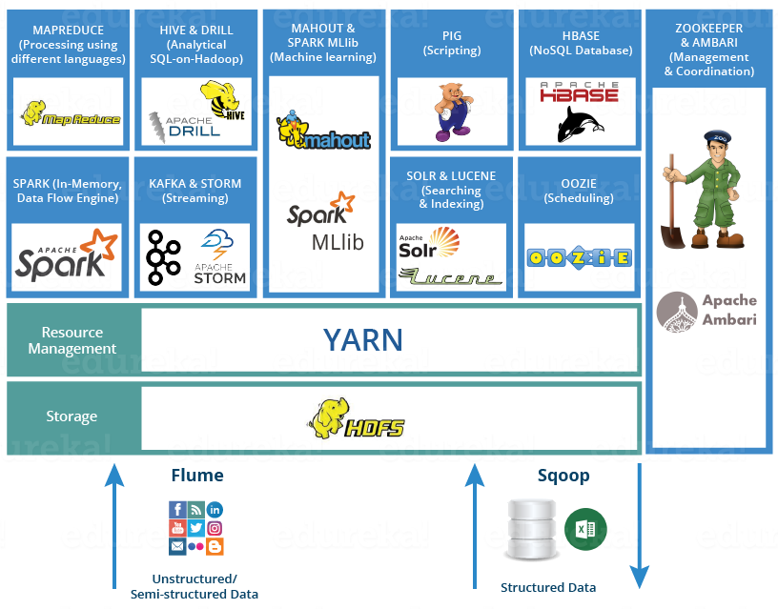
Hadoop Ecosystem

Slide 9
HDFS – Hadoop Distributed File System
HDFS is a Java-based file system that provides scalable and reliable data storage, and it was designed to span large clusters of commodity servers.
It is a scalable, fault-tolerant, distributed storage system that works closely with a wide variety of concurrent data access applications, coordinated by YARN.
Feature | Description
Rack Awareness | Considers a node’s physical location when allocating storage and scheduling tasks
Minimal data motion | Hadoop moves compute processes to the data on HDFS and not the other way around. Processing tasks can occur on the physical node where the data resides, which significantly reduces network I/O and provides very high aggregate bandwidth.
Utilities | Dynamically diagnose the health of the file system and rebalance the data on different nodes
Rollback | Allows operators to bring back the previous version of HDFS after an upgrade, in case of human or systemic errors.
Standby NameNode | Provides redundancy and supports high availability (HA)
Operability | HDFS requires minimal operator intervention, allowing a single operator to maintain a cluster of 1000s of nodes

Slide 10
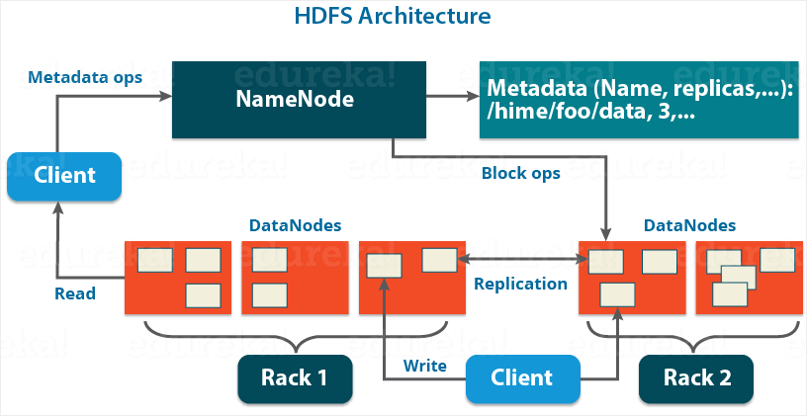
HDFS Architecture

Slide 11
YARN- Yet Another Resource Negotiator
YARN is the architectural center of Hadoop that allows multiple data processing engines such as interactive SQL, real-time streaming, data science and batch processing to handle data stored in a single platform, unlocking an entirely new approach to analytics.
YARN also extends the power of Hadoop to incumbent and new technologies found within the data center so that they can take advantage of cost effective, linear-scale storage and processing. It provides ISVs and developers a consistent framework for writing data access applications that run IN Hadoop.
Feature | Description
Multi-tenancy | YARN allows multiple access engines (either open-source or proprietary) to use Hadoop as the common standard for batch, interactive and real-time engines that can simultaneously access the same data set.
Cluster utilization | YARN’s dynamic allocation of cluster resources improves utilization over more static MapReduce rules used in early versions of Hadoop.
Scalability | YARN’s Resource Manager focuses exclusively on scheduling and keeps pace as clusters expand to thousands of nodes managing petabytes of data.
Compatibility | Existing MapReduce applications developed for Hadoop 1 can run YARN without any disruption to existing processes that already work

Slide 12
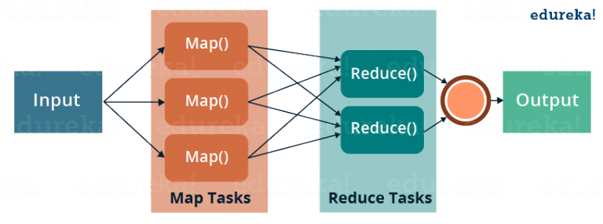
MapReduce
MapReduce is the heart of Apache Hadoop.
It is this programming paradigm that allows for massive scalability across hundreds or thousands of servers in a Hadoop cluster.
The term MapReduce actually refers to two separate and distinct tasks that Hadoop programs perform – map job and reduce job.
The first is the map job, which takes a set of data and converts it into another set of data, where individual elements are broken down into tuples (key/value pairs).
The reduce job takes the output from a map as input and combines those data tuples into a smaller set of tuples. The reduce job is always performed after the map job.

Slide 13

Three Phases of MapReduce
A MapReduce Program consists of three different phases. They are:
Mapper
Sort and Shuffle
Reducer
Mapper | Sort and Shuffle | Reducer
Mapper phase takes the input in the form of key value pairs (K,V), and generate the output in the form of (K,V). | Sort and Shuffle phase takes the input as (K,V) and generates the output in the form of Key and List of Value pairs (K, List(v)). | Reducer phase takes the input as (K, List(v)), and generates the output as (K,V). Reducer phase output is the Final Output.

Slide 14
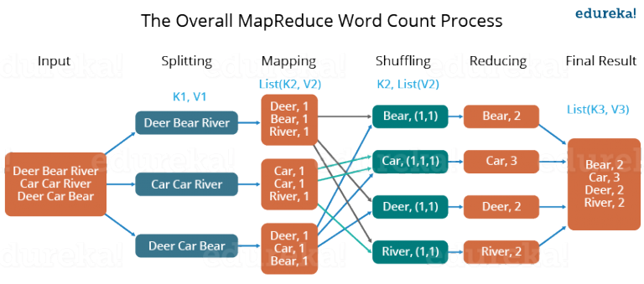
A Word Count Example of MapReduce

Slide 15
A Word Count Example of MapReduce
First, the input is divided in three splits. This distributes the work among all map nodes.
Then the words are tokenized in each mapper and given a hardcoded (1) value.
Now, a list of key-value pair is created where the key is nothing but the individual words and value is one. For example, for the first line (Dear Bear River), there are 3 key-value pairs – Dear, 1; Bear, 1; River, 1. The mapping process remains the same on all the nodes.
After mapper phase, a partition process takes place where sorting and shuffling happens so that all the tuples with the same key are sent to the corresponding reducer.
After the sorting and shuffling phase, each reducer will have a unique key and a list of values corresponding to that very key. For example, Bear, [1,1]; Car, [1,1,1].., etc.
Now, each Reducer counts the values which are present in that list of values. For example, Reducer gets a list of values which is [1,1] for the key Bear. Then, it counts the number of ones in the very list and gives the final output as – Bear, 2.
Finally, all the output key/value pairs are then collected and written in the output file.

Slide 16
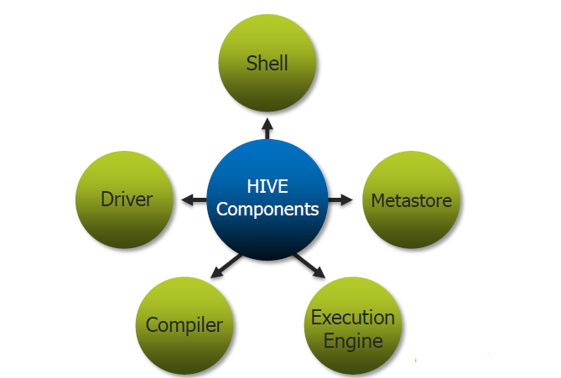
Apache Hive
Apache Hive is an ETL and Data warehousing tool built on top of Hadoop. It makes job easy for performing operations like
Analysis of huge datasets
Ad-hoc queries
Data encapsulation
Hive consists of the following major components:
Metastore – To store the metadata.
JDBC/ODBC – Query Compiler and Execution Engine to convert SQL queries to a sequence of MapReduce.
SerDe and ObjectInspectors – For data formats and types.
UDF/UDAF – For User Defined Functions.
Clients – Similar to MySQL command line and a web UI.

Slide 17
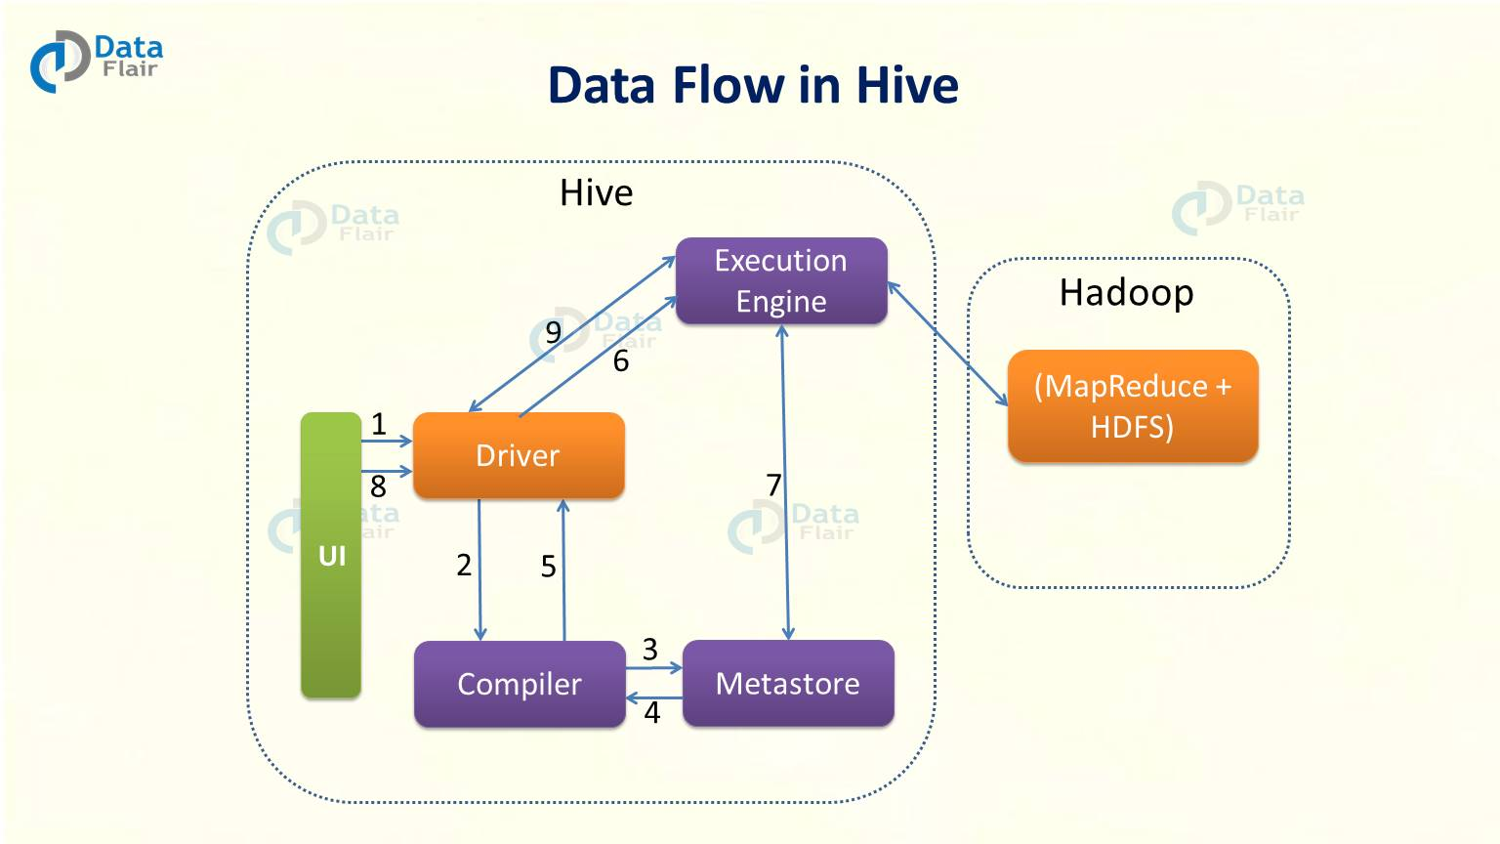
Apache Hive Architecture

Slide 18
Apache Hive Architecture
User Interface (UI) calls the execute interface to the Driver.
The driver creates a session handle for the query. Then it sends the query to the compiler to generate an execution plan.
The compiler needs the metadata. So it sends a request for getMetaData. Thus, receives the sendMetaData request from Metastore.
Now compiler uses this metadata to type check the expressions in the query. The compiler generates the plan which is DAG of stages with each stage being either a map/reduce job, a metadata operation or an operation on HDFS. The plan contains map operator trees and a reduce operator tree for map/reduce stages.
Now execution engine submits these stages to appropriate components. After in each task the deserializer associated with the table or intermediate outputs is used to read the rows from HDFS files. Then pass them through the associated operator tree. Once it generates the output, write it to a temporary HDFS file through the serializer. Now temporary file provides the subsequent map/reduce stages of the plan. Then move the final temporary file to the table’s location for DML operations.
Now for queries, execution engine directly read the contents of the temporary file from HDFS as part of the fetch call from the Driver.

Slide 19
Apache PIG
Apache Pig is a platform, used to analyze large data sets representing them as data flows. It is designed to provide an abstraction over MapReduce, reducing the complexities of writing a MapReduce program.
The features of Apache Pig are:
Rich set of operators − It provides many operators to perform operations like join, sort, filer, etc.
Ease of programming − Pig Latin is similar to SQL and it is easy to write a Pig script if you are good at SQL.
Optimization opportunities − The tasks in Apache Pig optimize their execution automatically, so the programmers need to focus only on semantics of the language.
Extensibility − Using the existing operators, users can develop their own functions to read, process, and write data.
UDF’s − Pig provides the facility to create User-defined Functions in other programming languages such as Java and invoke or embed them in Pig Scripts.
Handles all kinds of data − Apache Pig analyzes all kinds of data, both structured as well as unstructured. It stores the results in HDFS.

Slide 20
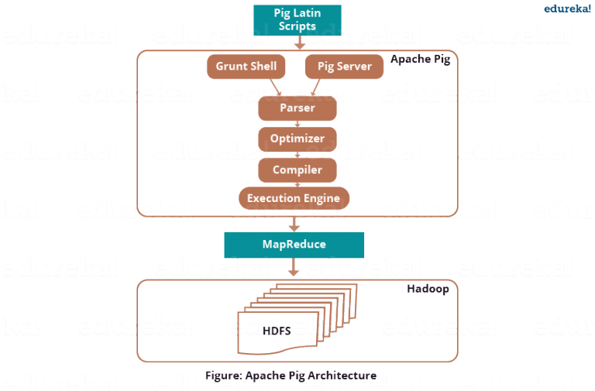
Apache Pig Architecture

Slide 21
Apache Pig Architecture
Pig Latin Scripts: There are three ways to execute the Pig script:
Grunt Shell: This is Pig’s interactive shell provided to execute all Pig Scripts.
Script File: Write all the Pig commands in a script file and execute the Pig script file. This is executed by the Pig Server.
Embedded Script: If some functions are unavailable in built-in operators, we can programmatically create User Defined Functions to bring that functionalities using other languages like Java, Python, Ruby, etc. and embed it in Pig Latin Script file. Then, execute that script file.
Parser: The Parser does type checking and checks the syntax of the script. It outputs a DAG (directed acyclic graph).
Optimizer: DAG is submitted to the optimizer. The Optimizer performs the optimization activities like split, merge, transform, and reorder operators
Compiler: After the optimization process, the compiler compiles the optimized code into a series of MapReduce jobs.
Execution Engine: MapReduce jobs are submitted for execution to the execution engine. Then the MapReduce jobs are executed and gives the required result. The results can be displayed on the screen using “DUMP” statement and can be stored in the HDFS using “STORE” statement.

Slide 22











Other Hadoop Tools
HBase: NoSQL Database
Mahout, Spark MLlib: Machine Learning
Apache Drill: SQL on Hadoop
Zookeeper: Managing Cluster
Oozie: Job Scheduling
Flume, Sqoop: Data Ingesting Services
Solr & Lucene: Searching & Indexing
Ambari: Provision, Monitor and Maintain cluster
Storm: real time computation system

Slide 23
Project Prerequisites
The H1-B visa data has more than 3 million records is the JSON format which have been converted into CSV form using HIVE's built in function.
The project has been completed using the following tools – MapReduce, Hive, Pig and Sqoop.
It is a menu based project created using shell scripting in Unix.

